Slide 1
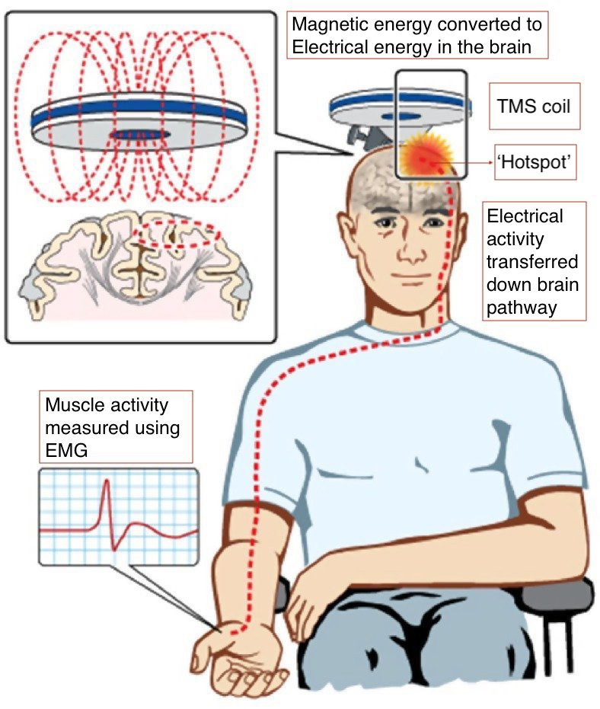
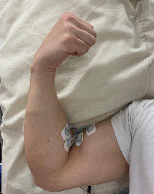
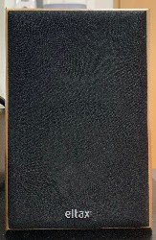
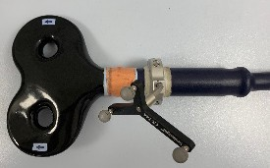
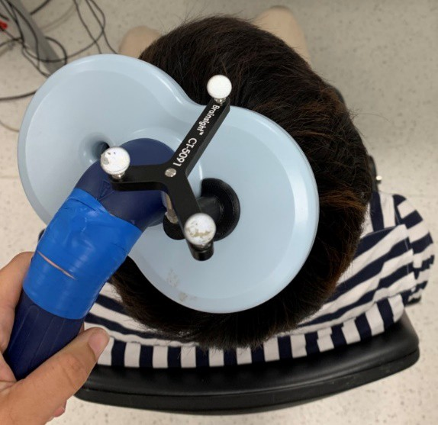
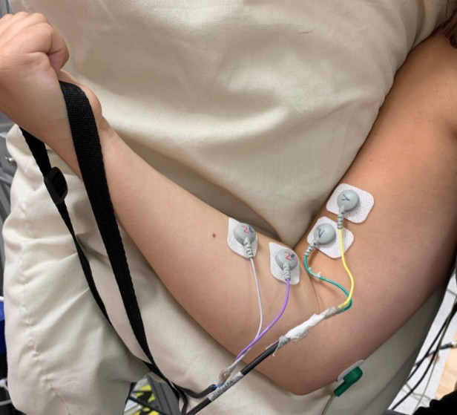
Modulation of Motor Pathway Using Loud Sounds and Transcranial Magnetic Stimulation
Jason Ting Siong Kai* (UG), Maria Germann (PhD), Professor Stuart Baker (Supervisor)
Bachelor of Medicine & Surgery (MBBS) Year 2, Medical School of Newcastle University Medicine (NUMed) Malaysia
*Student No: 170733254
Email: S.K.jason-ting2@newcastle.edu.my
Introduction
The muscles that help us move receive input from the brain via motor pathways, and movement is only possible if the motor pathways are intact.
In stroke/spinal cord injury, these motor pathways are damaged.
The Reticulospinal Tract (RST) is a motor pathway originating in a specific part of the brain called the Reticular Formation (RF).
Experimental Timeline
0 minutes
10 minutes,
20 minutes,
30 minutes
Magnetic fields converted to electrical activity
50ms
TMS coil
Electrical activity transferred down motor pathway
1. Baseline: Deliver 20 TMS pulses while the subject performs biceps curl.
2. Intervention: Deliver 50 or 200 pairs of startles and TMS pulses separated by 50ms.
3. Assessment: Deliver 20 TMS pulses while the subject performs biceps curl; repeat 0, 10, 20 & 30 minutes after the intervention.
MEPs are measured
It’s previously known that loud startling sounds can specifically activate² the RF and if presented 50ms before TMS, they suppress brain activity⁴, which in turn suppresses muscle responses.
Results & Discussion
Figure 1: Transcranial Magnetic Stimulation; TMS ¹
What is Transcranial Magnetic Stimulation (TMS)³?
TMS employs magnetic fields, which in turn induce unharmful electrical activity in the brain. This evokes involuntary, painless muscle movement. The muscle responses (also known as ‘Motor Evoked Potential’, MEP) are then measured to evaluate the motor pathways.
Muscle responses, MEPs (%)
Muscle responses, MEPs (%)
*
Number of Subjects
*
*
Number of Subjects
* Black dot = significant
* Black dot =
Objective
By continuously pairing loud startling sounds with TMS, two inputs which both converge on the RST, we would expect to see re-wiring of the RST that is long-lasting.
Using this paired stimulation, the project aims to enhance RST function, which could potentially have clinical implications for patients with reduced muscle function by virtue of stroke or spinal cord injury.
*
*
significant
Time (minutes) Time (minutes)
Figure 6: (Set A) LEFT: Recorded MEP size from biceps muscles before (bef), during (dur) and after (aft) 50 startles + TMS pairs. RIGHT: Number of subjects showing a change in MEP size
Time (minutes) Time (minutes)
Figure 7: (Set B) LEFT: Recorded MEP size from biceps muscles before (bef), during (dur) and after (aft) 200 startles + TMS pairs. RIGHT: Number of subjects showing a change in MEP size
Both experiment sets show a trend for increasing muscle response (MEP) size after the intervention (startle + TMS pairs). However, in Set A this increase does not reach significance.
With 200 stimuli pairings in experiment Set B, the increase in MEP size is statistically significant (p<0.05, Wilcoxon sign-rank test) and the majority of participants showed this effect. This increase lasts for at least 30 minutes after the intervention.
There is an expected suppression of MEPs during the intervention in both sets. This is because a loud startle presented 50ms before TMS is known to supress brain excitability⁴.
We propose that the facilitation seen after the intervention may be due to a re-wiring of the RST, the motor pathway which is directly activated by the startle.
However, control experiments are needed to confirm that the observed increase is due to the stimuli pairing and not the individual components of the intervention.
Methodology
A motion capture camera is used to ensure stable TMS coil position on the subject’s head.
130% AMT (minimum TMS intensity required to evoke 5 out of 10 MEPs) at 10% Maximum Voluntary Contractions (MVC) of biceps (subjects perform biceps curl until the colour bar goes up to the green region) is used.
Loud sounds (startles) are played from two speakers placed ~100cm from the subject with an intensity⁴ of 110 dB.
The interval⁴ between startles and TMS stimulation is fixed to be 50ms.
The MEPs are recorded using electrodes.
Conclusion
Pairing loud startling sounds with TMS repeatedly led to an increase in recorded muscle responses. This increase appears to be a long-term effect and might be due to a re-wiring of the RST. Control experiments will be carried out to further confirm this hypothesis in the near future.
20% MVC
10% MVC
Acknowledgements
I wish to extend my deepest gratitude to my supervisors, Maria Germann and Professor Stuart Baker
from Institute of Neuroscience, and also thank our participants who helped us with our experiments.
References
Rothwell, J.C., et al., Magnetic stimulation: motor evoked potentials. The International Federation of Clinical Neurophysiology. Electroencephalogr Clin Neurophysiol Suppl, 1999. 52: p. 97-103.
Vucic S, Ziemann U, Eisen A, Hallett M, Kiernan MC. Transcranial magnetic stimulation and amyotrophic lateral sclerosis: pathophysiological insights. Journal of Neurology, Neurosurgery &amp;amp; Psychiatry. 2013;84(10):1161.
Fisher, K.M., B. Zaaimi, and S.N. Baker, Reticular formation responses to magnetic brain stimulation of primary motor cortex.J Physiol, 2012. 590(16): p. 4045-60.
Furubayashi, T., et al., The human hand motor area is transiently suppressed by an unexpected auditory stimulus. Clin Neurophysiol, 2000. 111(1): p. 178-83.
2% MVC
Figure 2: MVC is tracked using a color bar
Figure 3: TMS with motion detector
Figure 4: Muscle responses (MEPs) measured with electrodes
Figure 5: MEP visible on graph
The funding for this project was provided by Newcastle University Undergraduate Research Scholarship and the International Spinal Research Trust.

